Slide 1
Boolean functions
Iakab Edward Alex – Group 913

Slide 2
Exercise 7.8
Simplify the following Boolean functions of 4 variables given by their values 1, using Quine’s method.
f₈(1,1,1,1) = f₈(1,1,1,0) = f₈(1,1,0,0) = f₈(1,0,0,0) = f₈(0,0,0,0) = f₈(0,0,1,0) = f₈(1,0,1,1) = f₈(0,0,1,1) = 1

Slide 3
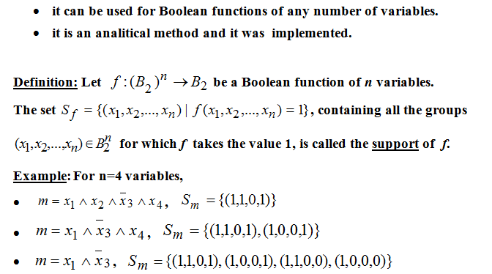
Quine’s method

Slide 4
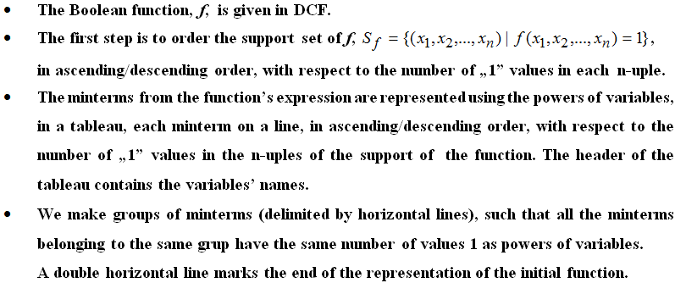

Slide 5
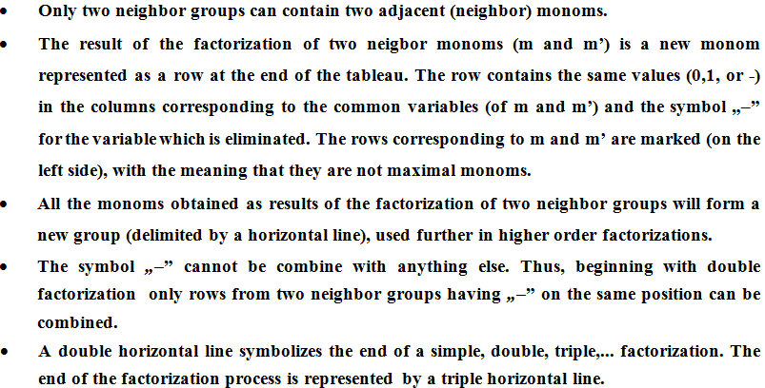

Slide 6
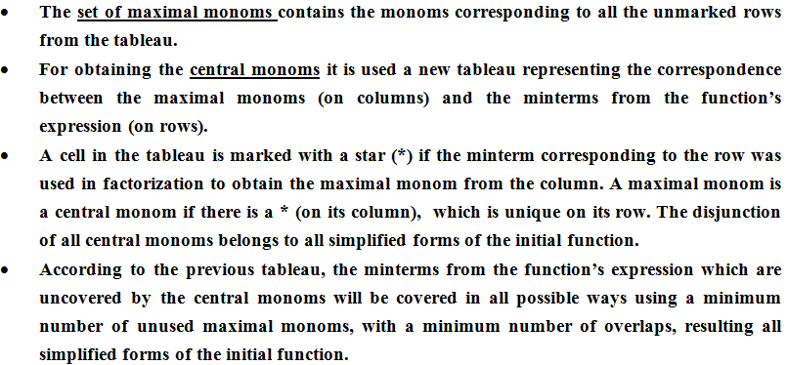

Slide 7
f₈(1,1,1,1) = f₈(1,1,1,0) = f₈(1,1,0,0) = f₈(1,0,0,0) = f₈(0,0,0,0) = f₈(0,0,1,0) = f₈(1,0,1,1) = f₈(0,0,1,1) = 1
f2 = m15 v m14 v m12 v m8 v m0 v m2 v m11 v m3
_ _ _ _ _ _ _ _ _ _ _ _ _ _ _ _
f2 = $x_{1}x_{2}x_{3}x_{4}$ v $x_{1}x_{2}x_{3}x_{4}$ v $x_{1}x_{2}x_{3}x_{4}$v $x_{1}x_{2}x_{3}x_{4}$ v $x_{1}x_{2}x_{3}x_{4}$ v $x_{1}x_{2}x_{3}x_{4}$ v $x_{1}x_{2}x_{3}x_{4}$ v $x_{1}x_{2}x_{3}x_{4}$
We find the support set of the function f
the support of f is the reunion of the supports of the minterms
a conjunction of variables if called a monom
a monom which contains all n variables of a function is called a canonical monom or a minterm
the support of f is represented in descending order, with respect to the number of “1” values in each 5-uple
Sf = {(x1, x2, …, xn) | f(x1, x2, …, xn) = 1} =>
Sf = {(1, 1, 1, 1), (1, 1, 1, 0), (1, 0, 1, 1), (1, 1, 0, 0), (0, 0, 1, 1), (1, 0, 0, 0), (0, 0, 1, 0), (0, 0, 0, 0)}

Slide 8
Sf = {(1, 1, 1, 1), (1, 1, 1, 0), (1, 0, 1, 1), (1, 1, 0, 0), (0, 0, 1, 1), (1, 0, 0, 0), (0, 0, 1, 0), (0, 0, 0, 0)} Step2: The factorization process
Representation | Group | Mark | x1 | x2 | x3 | x4
 | I | ✓ | 1 | 1 | 1 | 1 | m15
 | II | ✓ | 1 | 1 | 1 | 0 | m14
 |  | ✓ | 1 | 0 | 1 | 1 | m11
 | III | ✓ | 1 | 1 | 0 | 0 | m12
 | III | ✓ | 0 | 0 | 1 | 1 | m3
 | IV | ✓ | 1 | 0 | 0 | 0 | m8
 |  | ✓ | 0 | 0 | 1 | 0 | m2
 | V | ✓ | 0 | 0 | 0 | 0 | m0
Simple Factorization | VI = I + II |  | 1 | 1 | 1 | - | m15 v m14 = max1 = x1x2x3
 |  |  | 1 | - | 1 | 1 | m15 v m11 = max2 = x1x3x4
 | VII = II + III |  | - | 1 | 0 | 1 | m14 v m12 = max3 = x1x2x4
 |  |  | 1 | - | 0 | 1 | m11 v m3 = max4 = x2x3x4
 | VIII = III + IV |  | 0 | 0 | 1 | - | m12 v m8 = max5 = x1x3x4
 |  |  | 0 | 1 | 0 | - | m3 v m2 = max6 = x1x2x3
 | IX = IV + V |  | 0 | 0 | - | 0 | m8 v m0 = max7 = x2x3x4
 |  |  | 0 | - | 0 | 0 | m2 v m0 = max8 = x1x2x4

Slide 9
M(f) = {max1, max2, max3, max4, max5, max6, max7, max8}
the set of maximal monoms - 8 simple factorizations
_ _ _ _ _ _ _ _ _ _ _ _
max1 = x1x2x3; max2 = x1x3x4; max3 = x1x2x4; max4 = x2x3x4; max5 = x1x3x4; max6 = x1x2x3; max7 = x2x3x4; max8 = x1x2x4
Minterms/max monoms | max1 | max2 | max3 | max4 | max5 | max6 | max7 | max8
m15 |  | *
m14 |  |  | *
m11 |  | *
m12 |  |  | *
m3 |  |  |  |  |  | *
m8 |  |  |  |  |  |  | *
m2 |  |  |  |  |  | *
m0 |  |  |  |  |  |  | *
*
*
*
*
*
*
*
*
There is no "*" which is unique on its row => there are no central monoms => C(f) = ∅, third case of simplification.

Slide 10
Simplified form of f
To identify the simplified form(s) we have to choose a function:
h(x1, x2, x3, x4),
as simple as posible, such that they cover all the minterms:
(m15, m14, m12, m8, m0, m2, m11, m3).
We find a unique simplified form of f, fs. fs1(x1, x2, x3, x4) = max2 v max3 v max6 v max7 = x1x3x4 v x1x2x4 v x1x2x3 v x2x3x4 ( * ) fs2(x1, x2, x3, x4) = max1 v max4 v max5 v max8 = x1x2x3 v x2x3x4 v x1x3x4 v x1x2x4 ( )
*

